Slide 1
Different Types Of Software Testing & Wireframe
Presented By Anagha Suresh

Slide 2
What is an operating System?
An operating system manages the computer hardware, software resources and provides common services for computer program.
Functions of an operating system?
Resource management: The operating system manages the computer hardware such as CPU, memory, hard disk etc.
User Interface: Operating system provides Graphical user interface and command line interface.
Process management: The os manages the schedule and speed of the processing.
File System management: Deals with the management of file system operations such as create, read, write and delete.
Security Access control: The OS deals with user authentication and authorization.
Device management: Manages the activities of external device such as USB.

Slide 3
What is a Software?
It is a set of instructions and data that tells a computer how to perform specific task. There are three types of software’s:
System software: It act as interface between the user and the computer(e.g.: operating system).
Application software: It provides text editor tools which helps to perform various action in a text file (e.g.: MS Office).
Programming Software: It provides components such as language processor and compiler.
What is a Software Development?
It refers to a set of computer science activities dedicated to the process of creating, designing and supporting software. It is independent of hardware and makes computer programmable.
What is a Software Development Life Cycle(SDLC)?
It aims to produce high quality software that meets customer expectations and reaches completion between time and amount.

Slide 4

Introduction
In this presentation you will be able to learn about types of Software testing which is a critical process in the software development lifecycle, aimed at ensuring the quality, functionality, and reliability of software products. The types of software testing has divided into two: Manual Testing and Automated Testing.

Slide 5
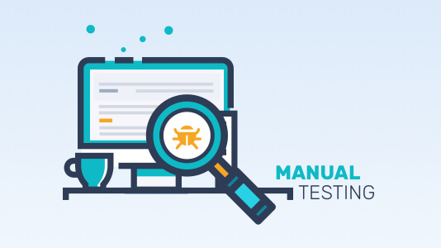
Manual Testing
Manual testing is a software testing process in which test cases or specific evaluations of a feature, function, or performance are executed without using any automated tools. Any deviation from an expected behavior or output could be considered a defect.

Slide 6
Types of Manual Testing are :
Unit Testing
Integration Testing
System Testing
Performance Testing
Usability Testing
Compatibility Testing

Slide 7
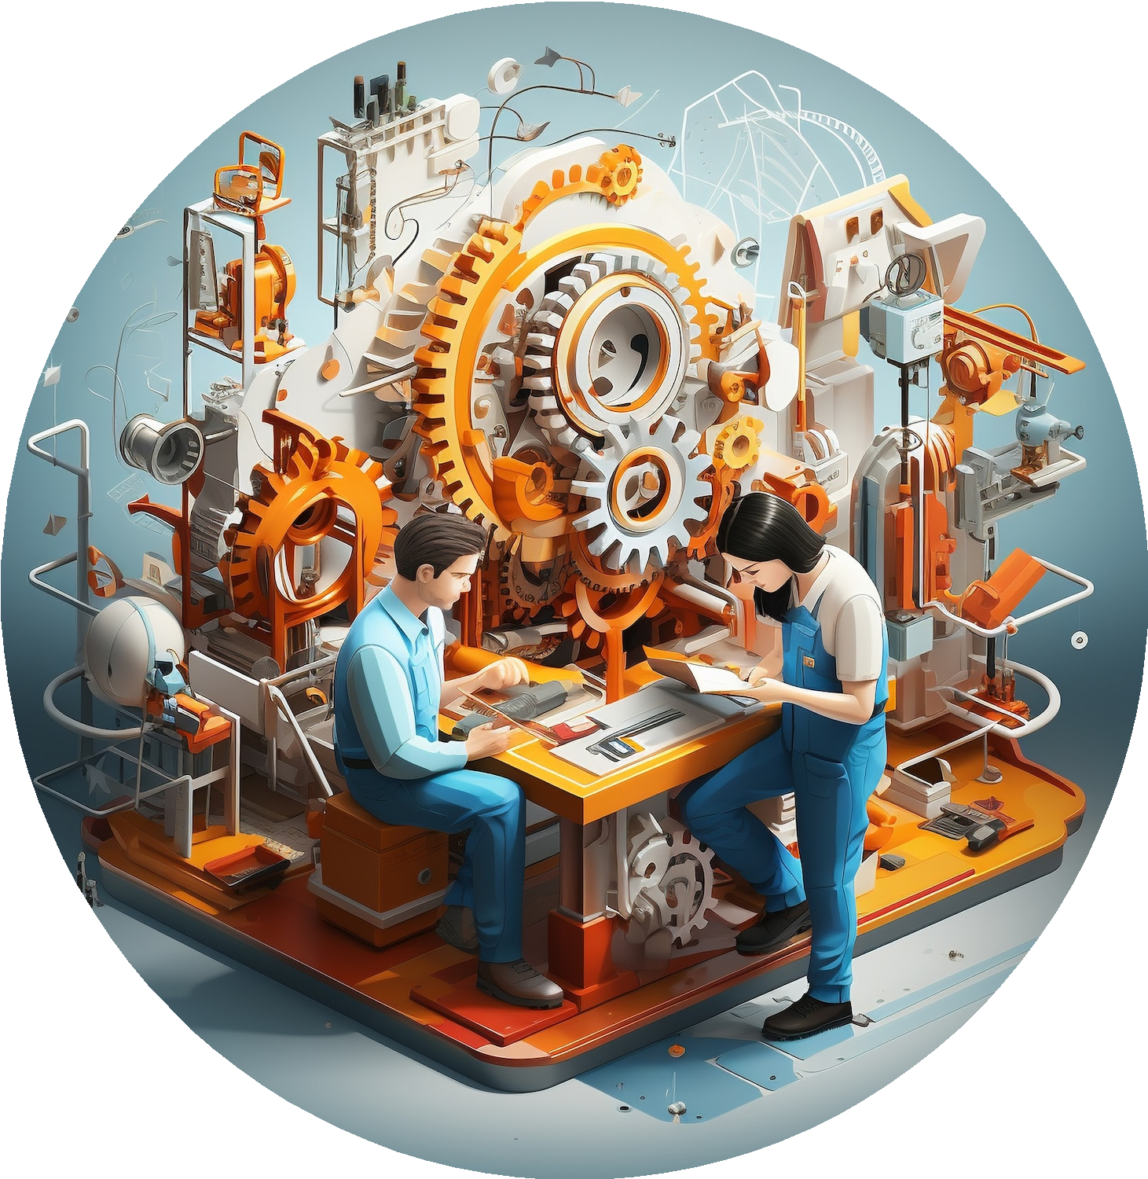
Unit Testing
Unit testing is a fundamental type of testing where individual units or components of a software are tested in isolation. It helps in identifying and fixing bugs early in the development cycle, ensuring better code quality and maintainability.

Slide 8
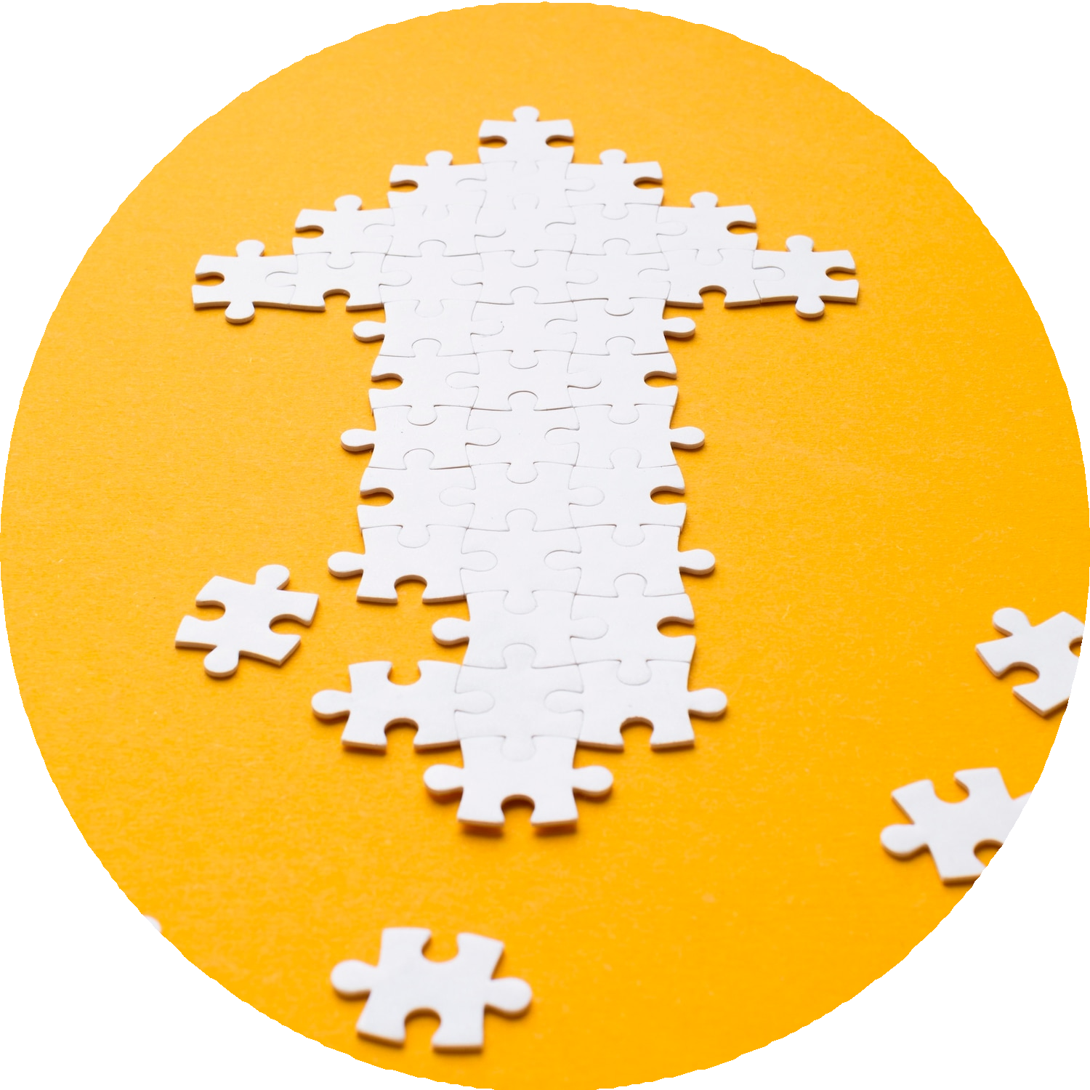
Integration Testing
Integration testing focuses on testing the interactions between different modules or components to ensure that they work together as expected. This type of testing is crucial in identifying interface issues and verifying data flow between integrated units.

Slide 9
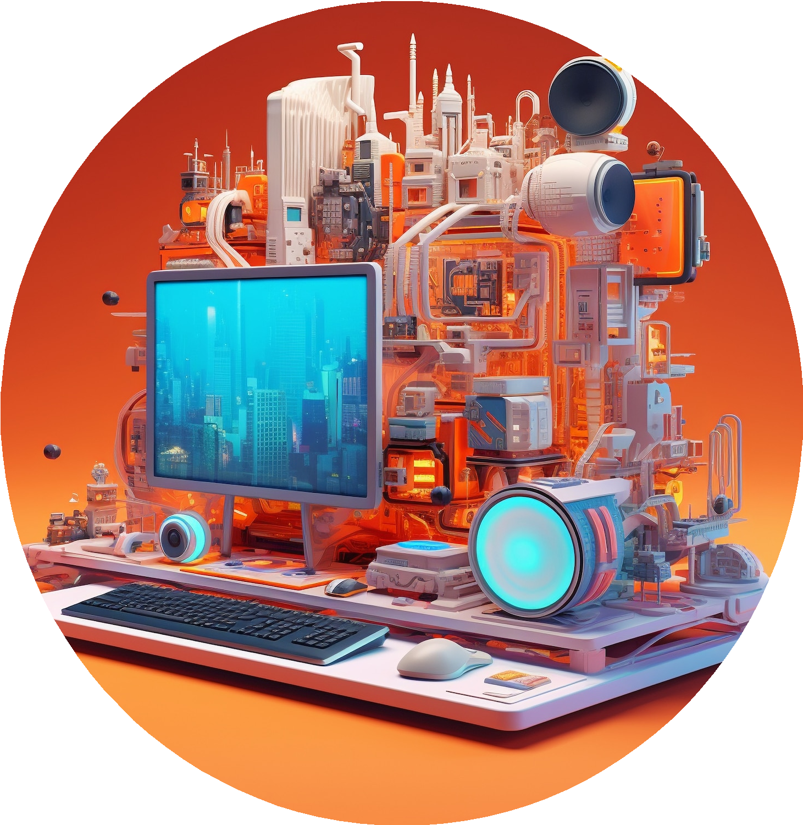
System Testing
In system testing, the entire software system is tested as a whole to validate that it meets the specified requirements. This type of testing helps in assessing the overall system functionality and
performance.

Slide 10

Performance Testing
Performance testing evaluates the responsiveness, scalability, and stability of the software under various workloads. This type of testing helps in identifying and addressing performance bottlenecks and ensuring optimal system performance.

Slide 11

Usability Testing
Usability testing is crucial for evaluating a product's user experience. By observing real users interact with the product, designers can identify issues and make improvements. This process helps ensure that the product is intuitive, easy to use, and meets the needs of its target audience.

Slide 12

Compatibility Testing
Compatibility testing in software ensures applications work across different environments. It validates functionality, performance, and user experience on various systems, browsers, and devices. This testing phase is crucial to guarantee seamless operation and user satisfaction, reducing potential issues post-deployment.

Slide 13

Automation Testing
In automation testing, test cases are executed using automated tools and scripts, reducing manual effort and enabling faster feedback on the software's quality. This type of testing is essential for achieving continuous testing in agile and DevOps environments.

Slide 14
What is a Wireframe?

Slide 15
Wireframe
A wireframe is a skeletal blueprint of a digital product's layout, serving as a fundamental tool in the design process. It outlines the basic structure and elements of a webpage or app, including the placement of headers, footers, navigation menus, content sections, and interactive components, without delving into detailed design elements like color schemes, typography, or imagery.

Slide 16
Types of Wireframes:
Low-fidelity wireframes are basic wireframes focused on layout, navigation, and information architecture. They show what the interface will look like, illustrating user flows with key UI design elements.
Mid-fidelity wireframes help designers iterate and shape the final design. Design teams may add annotations and content as they try out different approaches to user flows and UI design elements, mapping out core functionality and key interactions.
3.High-fidelity wireframes look like early product mockups, with interactive and visual design elements—but without the functionality of low-fidelity prototypes. At this point of the design process, you may want to add brand elements like fonts, colors, and logos.

Slide 17
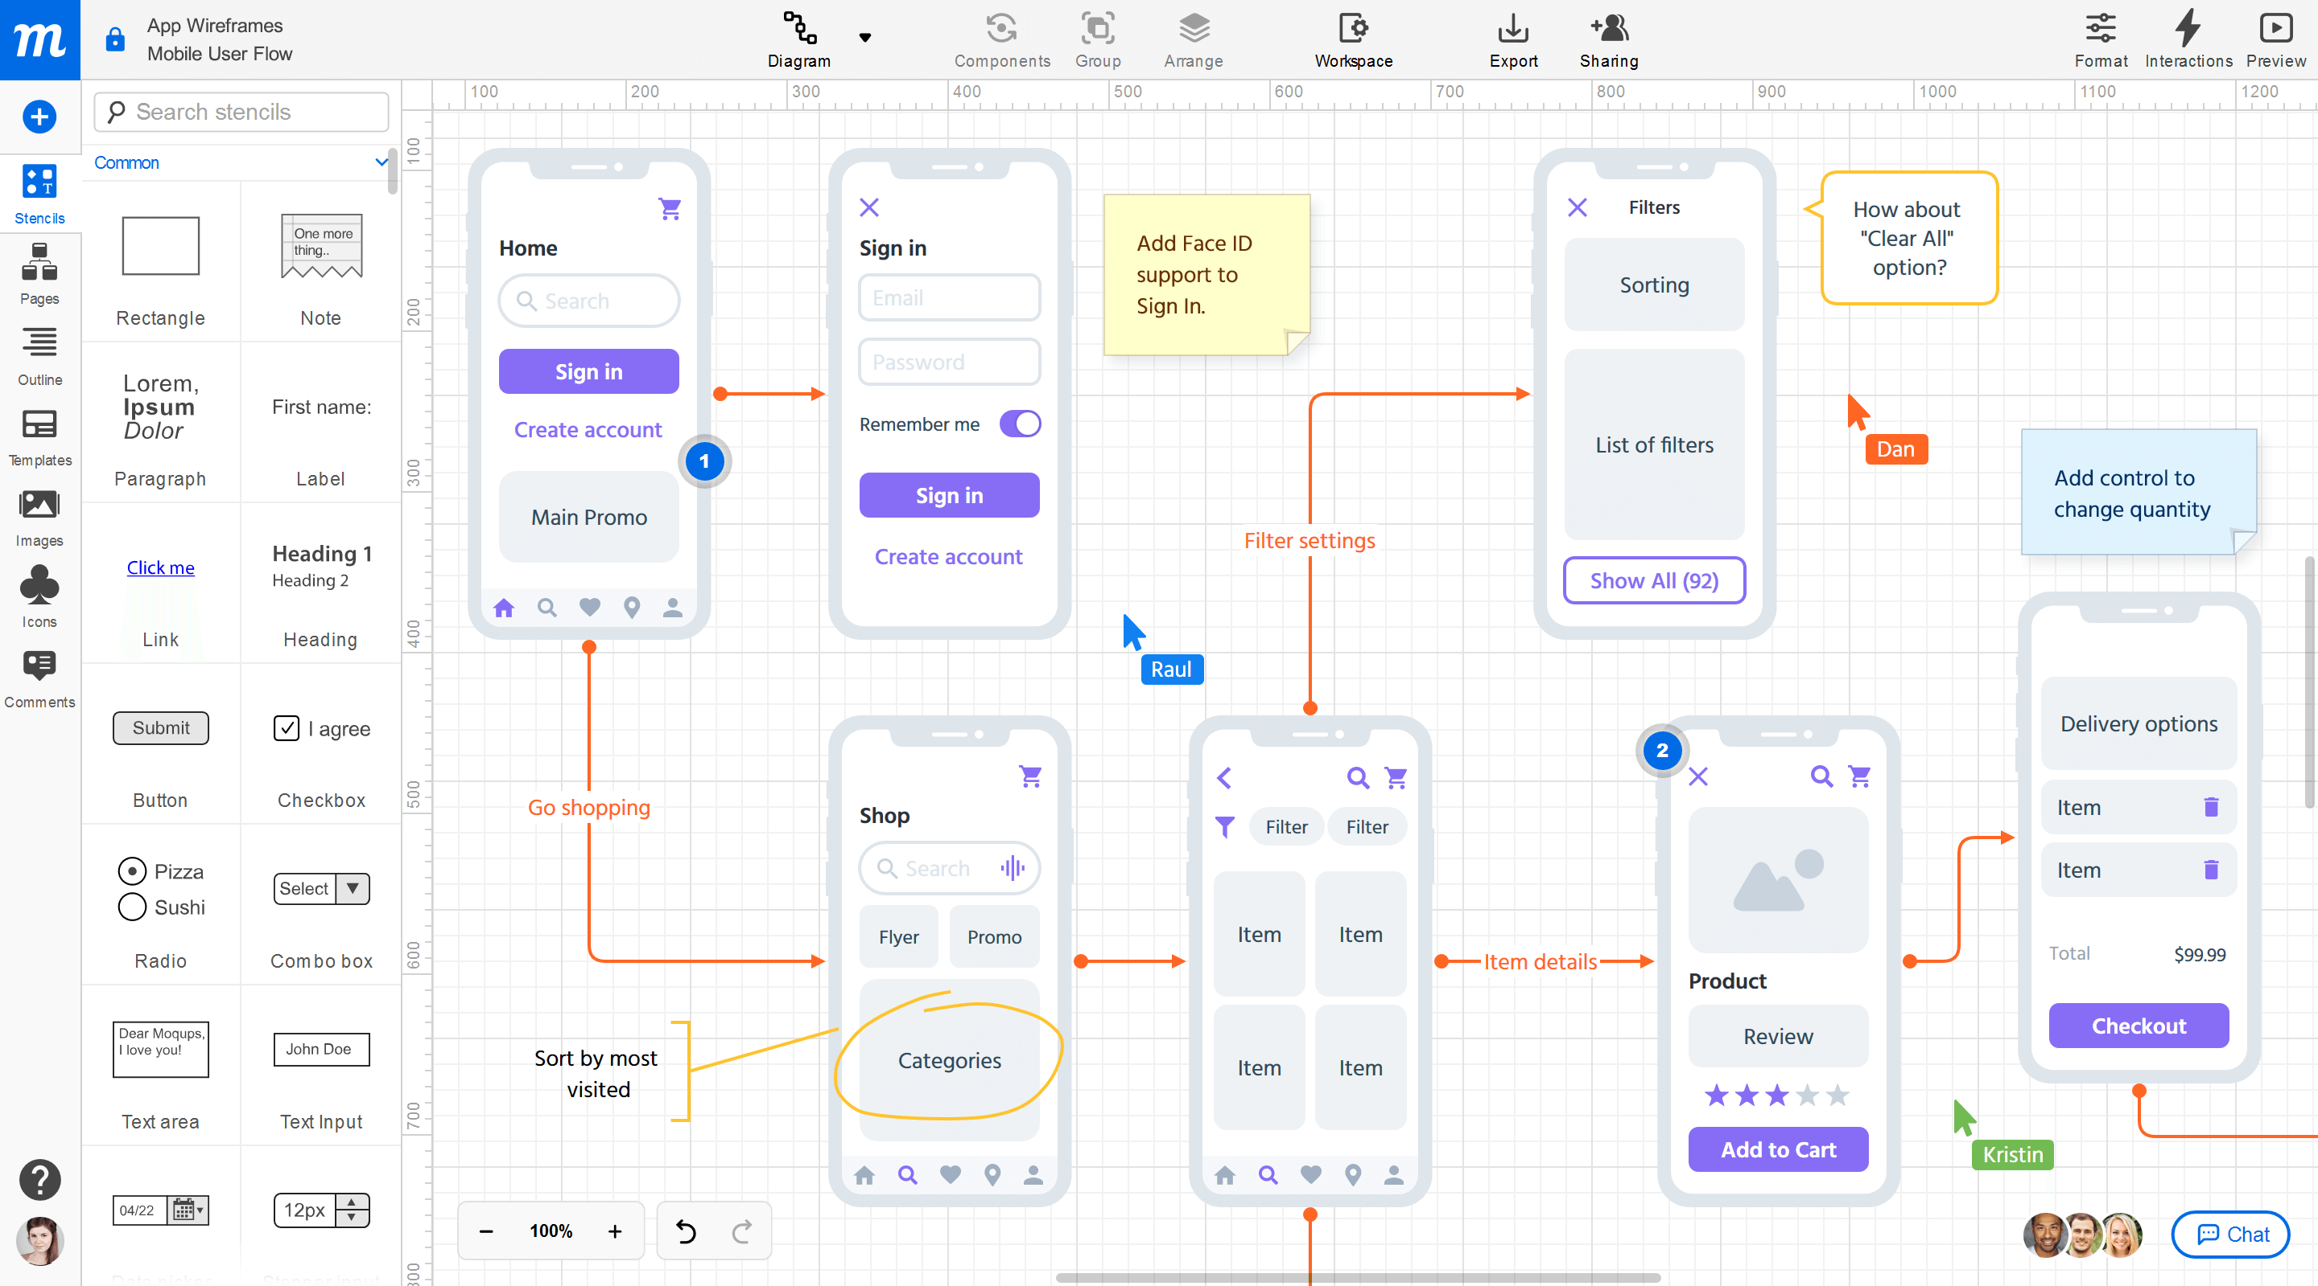
Tools for wireframe:
Sketch for detailed, vector-based design
Moqups for beginners
Figma for a free wireframe app
UXPin for handing off design documentation to developers
MockFlow for project organization
Justinmind for interactive wireframes
Uizard for AI-assisted wireframing

Slide 18
Software Development Models:
Software development models are various processes or methods that are chosen for project development depending on the objectives and goals of the project. Many development life cycle models have been developed to achieve various essential objectives. Models specify the various steps of the process and the order in which they are executed. There are 8 software developments models, they are the following:
Waterfall Model
Iterative Model

Slide 19
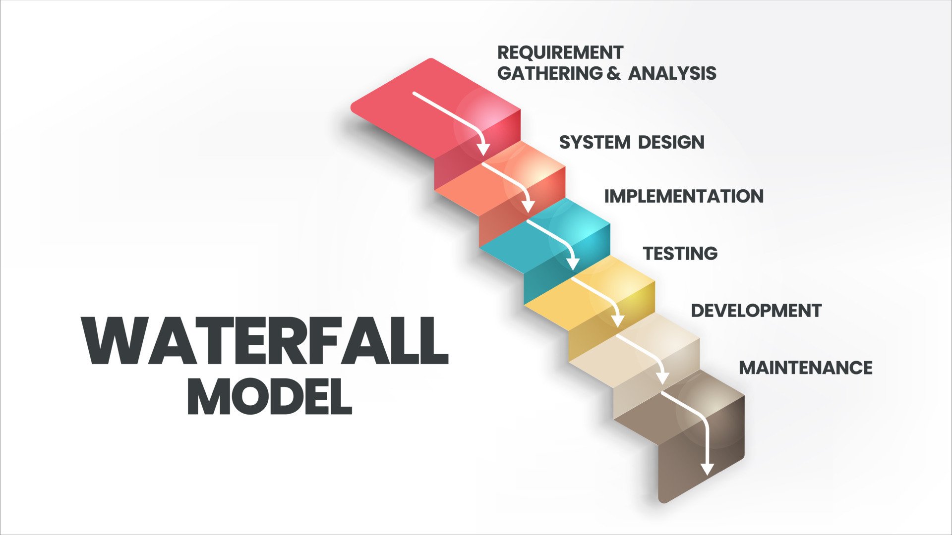
Waterfall Model
Waterfall model is a famous and good version of SDLC(System Development Life Cycle) for software engineering. The waterfall model is a linear and sequential model, which means that a development phase cannot begin until the previous phase is completed. We cannot overlap phases in waterfall model.

Slide 20
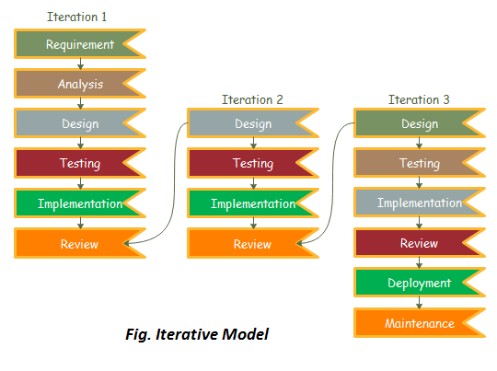
Iterative Model
In Iterative model we start developing the software with some requirements and when it is developed, it is reviewed. If there are requirements for changes in it, then we develop a new version of the software based on those requirements. This process repeats itself many times until we get our final product.
So, in Iterative model a software is developed by following several iterations. Iteration means that we are repeating the development process again and again.

Slide 21
Conclusion
By understanding the different types of software testing, organizations can establish a robust testing strategy to ensure the delivery of high-quality software products. Embracing a comprehensive approach to software testing is essential for achieving customer satisfaction and maintaining a competitive edge in the market.

Slide 22
Thank You!

